Slide 1
Panerai Visualization and Model
EDHEC-DAAI-DS-Group 10

Slide 2
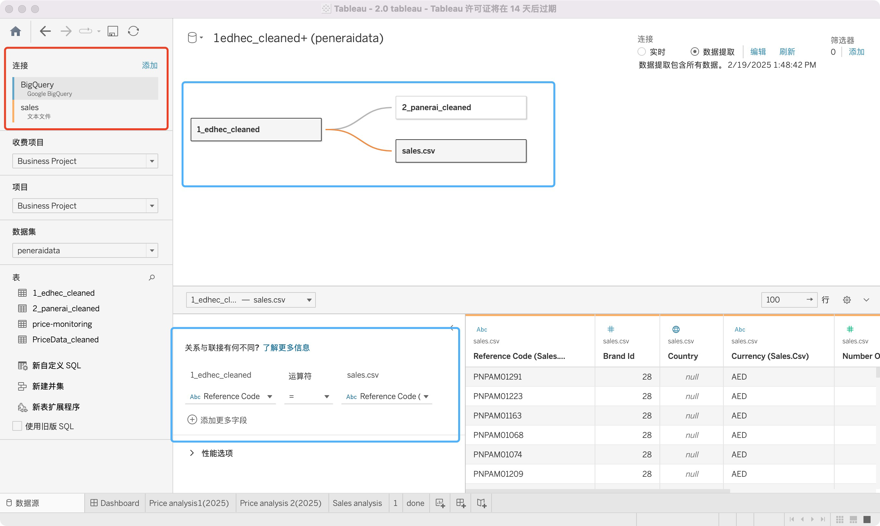
Data source connection
We use Tableau to connect to BigQuery data tables to get business insights analysis.
A total of three tables are used:
edhec_cleaned and sales, which are extracted from BigQuery’s public dataset using SQL
panerai, which we scraped ourselves using custom code.
All the table were connected by ‘Reference Code’

Slide 3
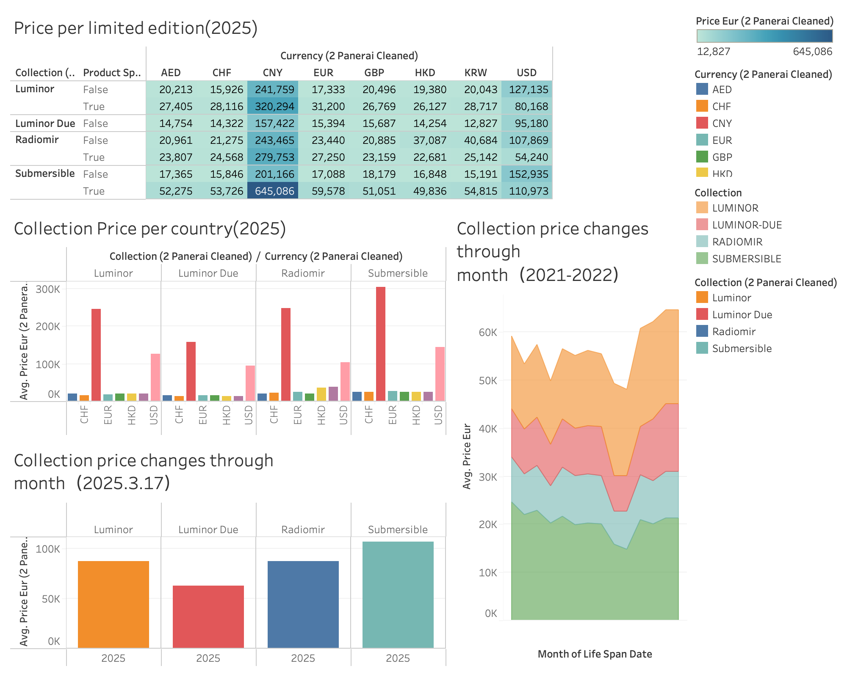
Price per limited edition:
Limited Edition Premium: Across all collections, the price of limited edition ("True" under Product Sp.) watches is consistently higher than non-limited editions ("False"), reflecting the premium associated with exclusivity.
Submersible Collection Stands Out: The Submersible collection has the highest price disparity between limited and non-limited editions, especially in CNY (201,166 vs. 645,086) and USD (152,935 vs. 110,973). This suggests that exclusivity in this collection carries a significantly higher premium.
Radiomir vs. Luminor: The Radiomir and Luminor collections maintain similar price patterns, with limited editions showing a moderate price increase compared to standard models. However, Luminor Due has the smallest price gap between limited and non-limited editions, suggesting it may be positioned differently in the market.

Slide 4
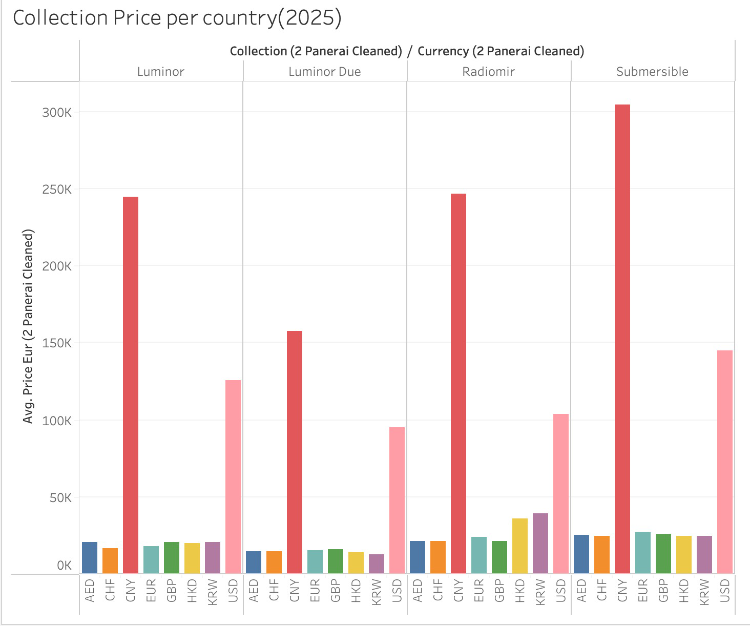
Collection Price per country：
The same collection has significant pricing differences in different countries, for example, prices in CNY and USD are significantly higher compared to USD, HKD and other currencies, indicating a strong focus on the European market or higher luxury taxes in these regions.
Two collections saw significant price increases: the Submersible and Radiomir collections, likely due to limited edition models, which drive prices higher, reinforcing their exclusivity and high valuation.

Slide 5
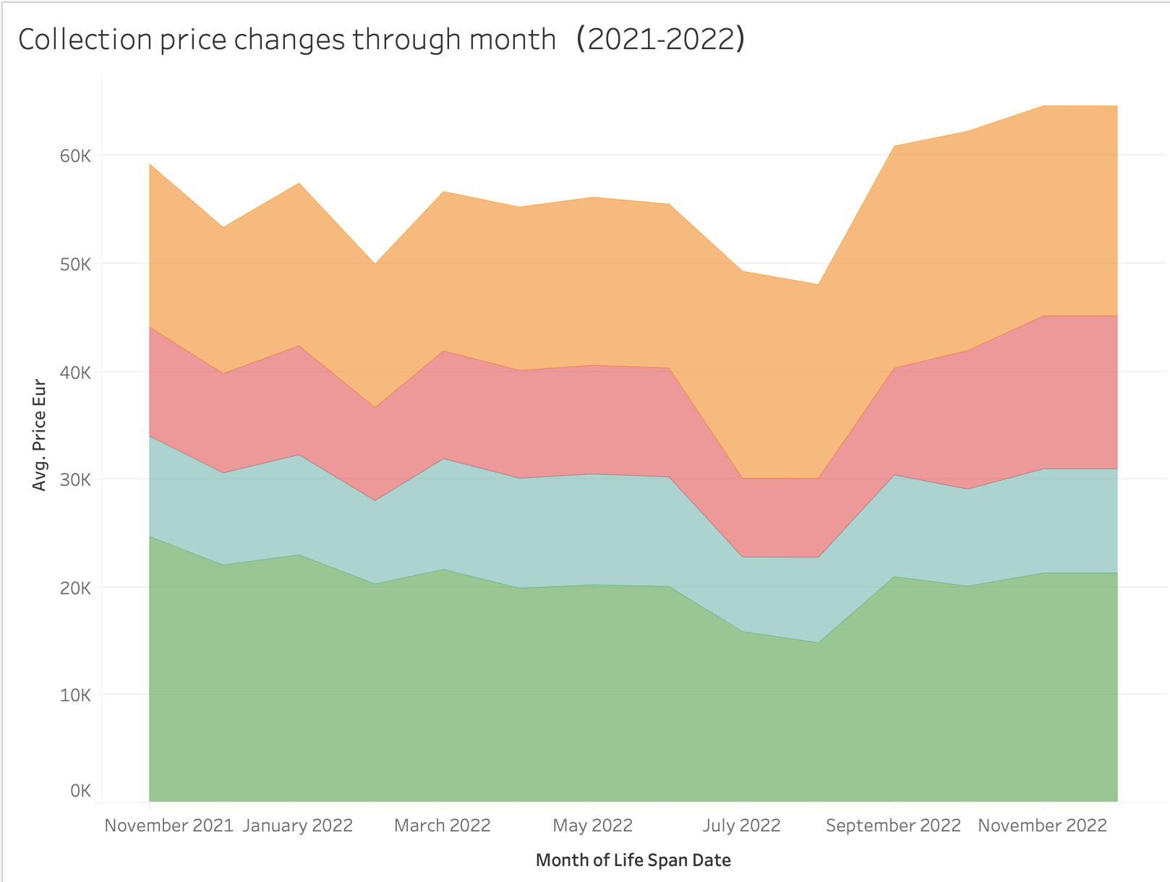
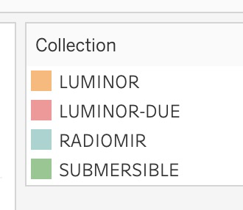
Collection price changed through month(2021-2022)：
The graph shows the monthly price changes of four Panerai series (Luminor, Luminor Due, Radiomir and Submersible) from 2021 to 2022.
Overall, prices show a stable but volatile trend, with occasional declines (especially around July 2022), followed by a steady rise at the end of 2022.
Market recovery at the end of 2022: Prices rebounded sharply after mid-year fluctuations.
Guessed reason 3:the economy has recovered after the end of the epidemic, and everyone's spending power has increased, so the price of luxury goods has risen.
Guessed reason 2: Due to the impact of the epidemic, the cost of each link in the production, sales and promotion of luxury goods has increased, resulting in an increase in the price of luxury goods.
Guessed reason 3: Competitor trend, stronger and higher-priced competitors have emerged, and the brand positioning needs to be unified.

Slide 6
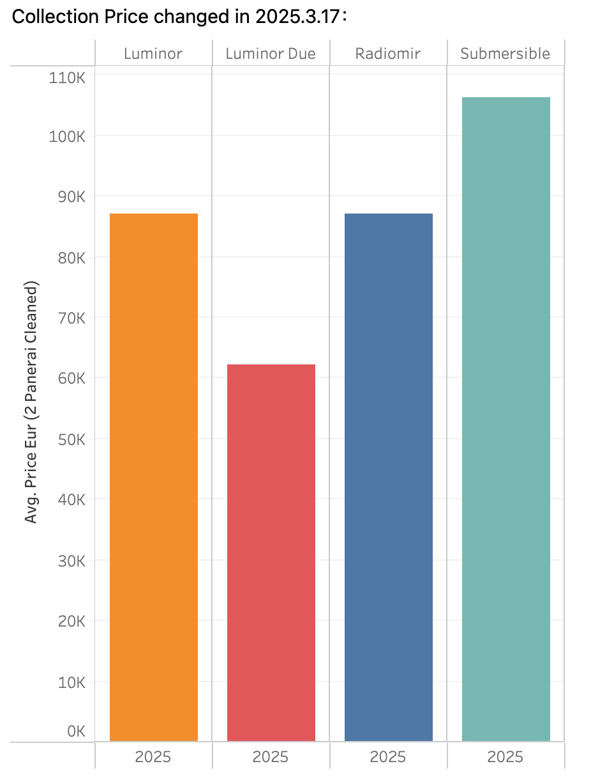
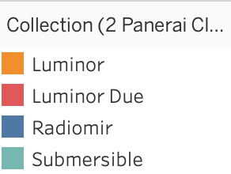
Collection Price changed in 2025.3.17：
The right graph focuses on the average price forecast for 2025, comparing different series.
Submersible has become the most expensive series, exceeding 100,000 euros, indicating that it continues to maintain a high-end positioning.
Luminor and Radiomir are at similar price levels, both hovering around 85,000 euros.
Luminor Due remains the most affordable, staying below 65,000 euros, consolidating its position as an entry-level luxury line.
Submersible remains the high-end luxury line, while Luminor Due remains the most accessible.

Slide 7
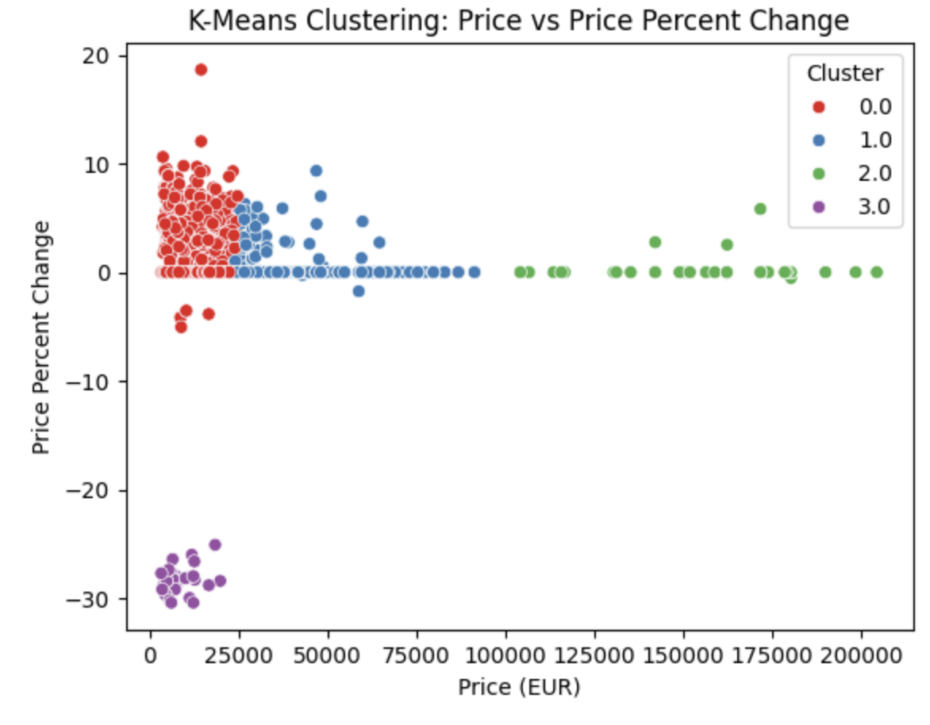
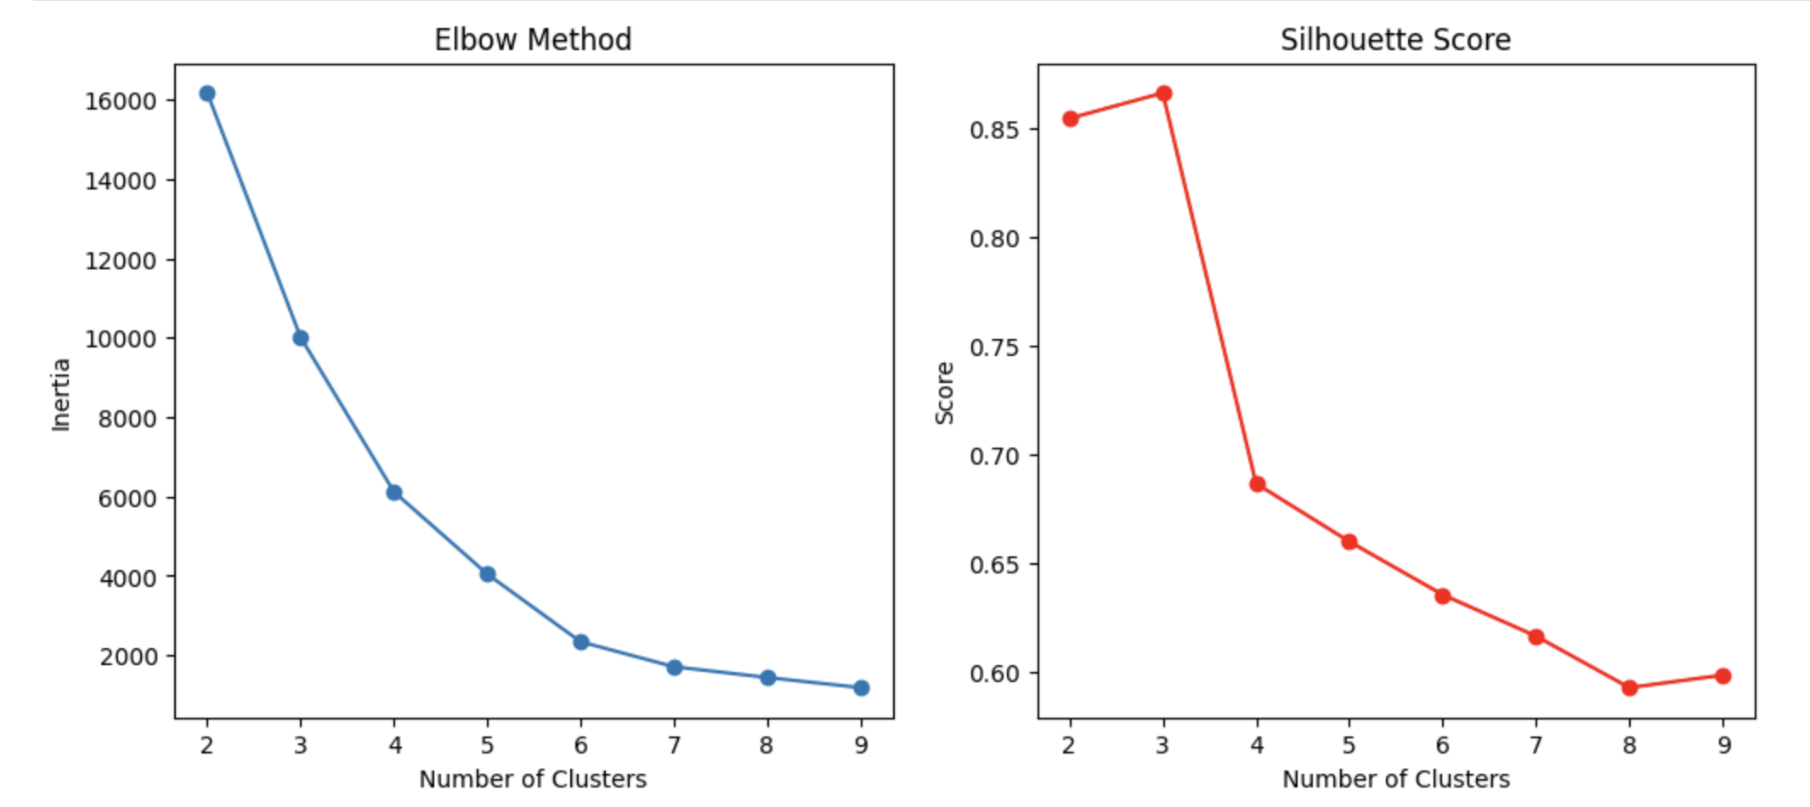
Interpretation for the Model Output:

Slide 8
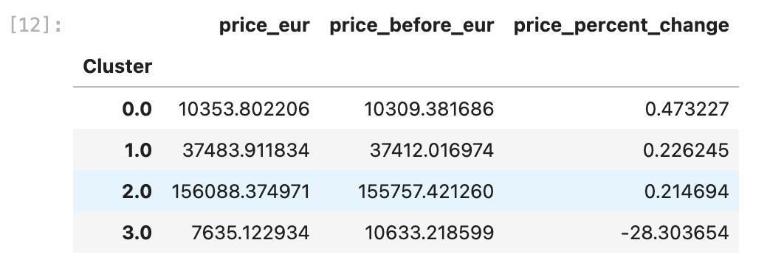
Interpretation for the Model Output:
# Model:
K-means Clustering: We want to discover different watch pricing strategies or market segments.
Interpretation:
Cluster 0: price_eur: 10,353.80 EUR, price_before_eur: 10,309.38 EUR, price_percent_change: 0.47%
This cluster consists of watches with moderately high prices, and the price increase is modest at 0.47%. These watches may represent a mid-range category with a small increase in price, indicating relatively stable market conditions or incremental adjustments.
Cluster 1:price_eur: 37,483.91 EUR, price_before_eur: 37,412.02 EUR, price_percent_change: 0.23%
Watches in this cluster have high prices (around 37,483.91 EUR), but the price change is very small (0.23%). These products likely belong to the higher-end or premium market, with stable pricing and little fluctuation over time.
Cluster 2: price_eur: 156,088.37 EUR, price_before_eur: 155,757.42 EUR, price_percent_change: 0.21%
This cluster represents extremely high-priced watches with a minimal price increase of just 0.21%. These are likely ultra-luxury items with very stable prices. The minimal change in price reflects high market stability and exclusivity, where prices don’t fluctuate much over time.
Cluster 3: price_eur: 7,635.12 EUR, price_before_eur: 10,633.22 EUR, price_percent_change: -28.30%
This cluster stands out with a significant price decrease of -28.30%. The original price was 10,633.22 EUR, but the current price dropped to 7,635.12 EUR. This could indicate either a market correction, a seasonal discount, or a temporary shift in demand. This price reduction may reflect lower-priced models or promotional pricing strategies.
In conclusion: Cluster 0, Cluster 1, and Cluster 2 represent moderately priced, high-priced, and ultra-luxury watches, all with stable pricing trends.
Cluster 3 represents a category with significant price reduction, possibly due to external factors like market adjustments or promotional pricing.

